Slide 1
OPTIMIZATION – II
Mini Project - II
Saurabh Mehra
Rohan Joseph
29 April 2018

Slide 2
Outline
Problem definition
Methodology selection
Experiment design
Computational results
Questions

Slide 3
Problem Definition
We have selected two problems in machine learning which serve as basis for explaining various convex optimization algorithms.
Problem1:
Determine whether a NBA team will make it to playoffs in a season based on the point difference between points scored and points conceded.
Problem2:
Classify the location of a house based on two attributes – Size (Square feet) and Price per square feet.

Slide 4
Problem 1: Moneyball in NBA
Definition:
Whether a team will make it to playoffs or not? Train a model to determine the points difference of a NBA team in a season based on historical data of ~30 teams from 1980 to 2011 seasons. Use this trained model to predict the points difference of a team in 2013 season.
Based on historical data, if a team has a point difference of greater than 31 points, it has 98% chance of making it to playoffs.
Features:
FieldGoals | FieldGoalsA | 2P | 2PA | 3P | 3PA | FreeThrows
FreeThrowsA | OffenseRebound | DefenseRebound | Assists | Steals | Blocks | Turnovers

Slide 5
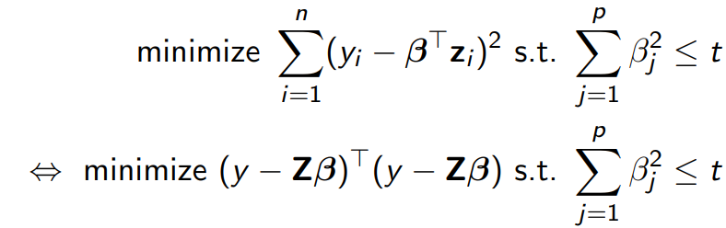
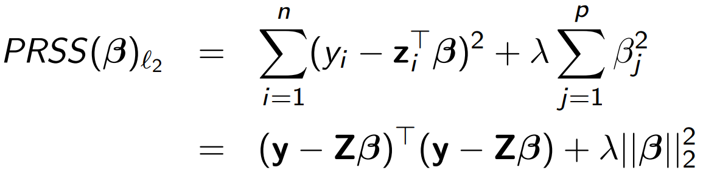
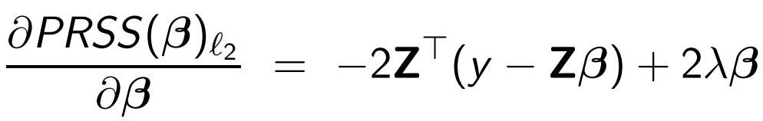
Problem 1: Methodology
Ridge Regression
We can write the ridge constraint as the following penalized residual sum of squares (PRSS):
Its solution may have smaller average prediction error than βˆ ls
PRSS(β)ℓ2 is convex, and hence has a unique solution
Taking derivatives, we obtain:

Slide 6
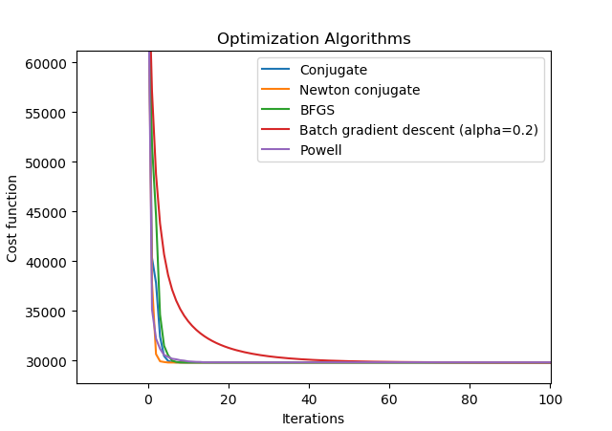
Problem 1: Computational results
Unconstrained Optimization Algorithms:
Conjugate gradient descent: Polak - Ribiere modification. Converges to global minimum in ~10 iterations.
Newton conjugate gradient: Fastest to converge (~6 iterations). Converges to global minimum.
Quasi Newton method (BFGS): Converges to global minimum in ~12 iterations.
Batch gradient descent: Takes longest to converge but converges to global minimum in ~90 iterations. For alpha>0.2, the method does not converge.
Powell conjugate direction method: Converges in ~15 iterations but do not converge to global minimum.

Slide 7
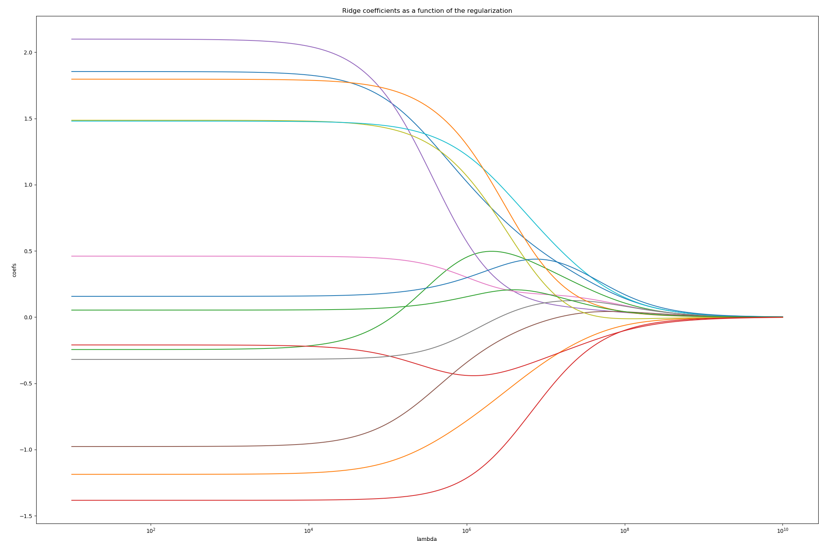
Problem 1: Computational results
Ridge regression results accuracy:
Optimal Objective value | 29817
RMSE test data | 174.73
R-2 coefficient for test data | 0.8714
Of the 14 teams that qualified for the playoffs in the 2013 season, we accurately predicted 12 of them based on the point difference figures predicted from the model.
lambda = 100 results in optimal test error

Slide 8
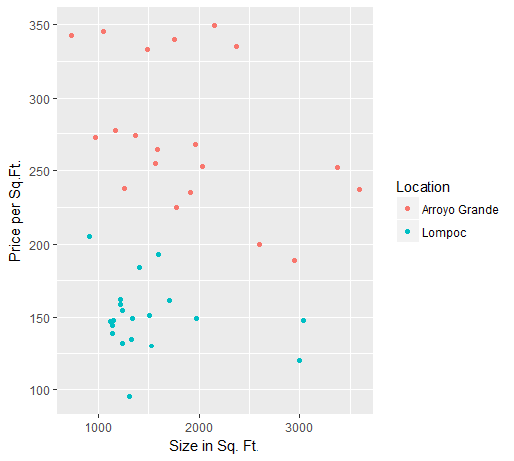
Problem 2: Housing Prices
Objective : Classify the location of a house based on two attributes – Size (Square feet) and Price per square feet. The class is ‘Location’.
Dataset : • Location : City in California (Arroyo Grande/Lompoc) • Price per Square Feet • Size in Square Feet
Sample data :
Location | Price | Size
Arroyo Grande | 335.3 | 2371
Arroyo Grande | 237.87 | 1257
Arroyo Grande | 340 | 1750
Arroyo Grande | 333.11 | 1486
Arroyo Grande | 349.18 | 2145
Arroyo Grande | 188.63 | 2947
Arroyo Grande | 240.63 | 827
Lompoc | 130.32 | 1527
Arroyo Grande | 220.44 | 6800
Lompoc | 161.76 | 1700
Arroyo Grande | 351.14 | 5411
Lompoc | 204.93 | 912

Slide 9
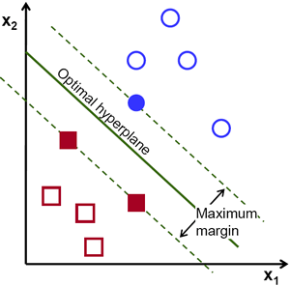
Support Vector Machines
Problem 2: Methodology
Support Vector Machine (SVM) is a supervised machine learning algorithm which can be used for both classification problems
In this algorithm, we plot each data item as a point in n-dimensional space (where n is number of features you have) with the value of each feature being the value of a particular coordinate. Then, we perform classification by finding the hyper-plane that differentiate the two classes very well
If the training data is linearly separable, we can select two parallel hyperplanes that separate the two classes of data, so that the distance between them is as large as possible
The region bounded by these two hyperplanes is called the "margin", and the maximum-margin hyperplane is the hyperplane that lies halfway between them

Slide 10
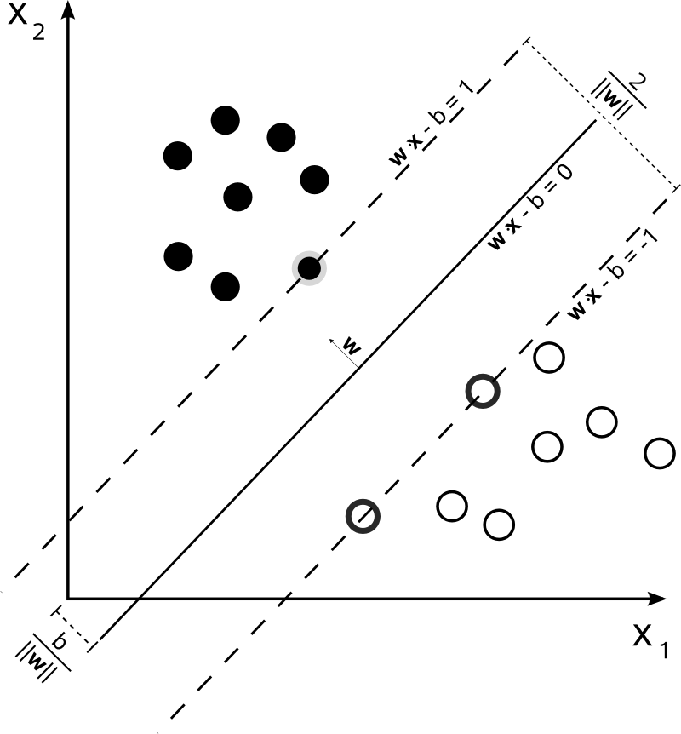
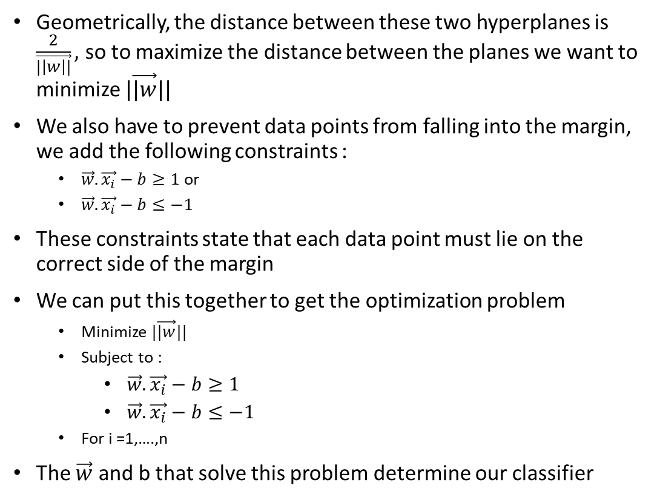
Problem 2: Methodology
Support Vector Machines
Geometrically, the distance between these two hyperplanes is $\frac{2}{\vec{|\left|w\right||}},$ so to maximize the distance between the planes we want to minimize $|\vec{|w}||$
We also have to prevent data points from falling into the margin, we add the following constraints :
$\vec{w}.\vec{x_{i}}−b≥1$or
$\vec{w}.\vec{x_{i}}−b≤−1$
These constraints state that each data point must lie on the correct side of the margin
We can put this together to get the optimization problem
Minimize $|\vec{|w}||$
Subject to :
$\vec{w}.\vec{x_{i}}−b≥1$
$\vec{w}.\vec{x_{i}}−b≤−1$
For i =1,….,n
The $\vec{w}$ and b that solve this problem determine our classifier

Slide 11
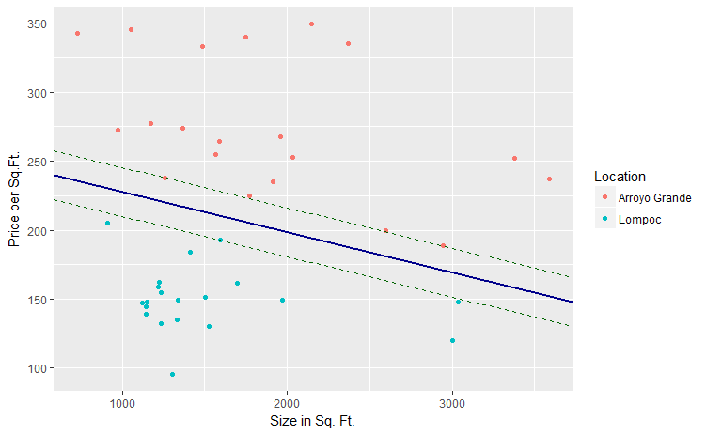

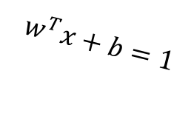
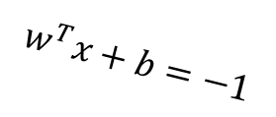
Problem 2: Computational results
Objective : Classify the location of a house based on two attributes – Size (Square feet) and Price per square feet. The class is ‘Location’.
Dataset : • Location : City in California (Arroyo Grande/Lompoc) • Price per Square Feet • Size in Square Feet
Sample data :
Location | Price | Size
Arroyo Grande | 335.3 | 2371
Arroyo Grande | 237.87 | 1257
Arroyo Grande | 340 | 1750
Arroyo Grande | 333.11 | 1486
Arroyo Grande | 349.18 | 2145
Arroyo Grande | 188.63 | 2947
Arroyo Grande | 240.63 | 827
Lompoc | 130.32 | 1527
Arroyo Grande | 220.44 | 6800
Lompoc | 161.76 | 1700
Arroyo Grande | 351.14 | 5411
Lompoc | 204.93 | 912
$$w^{T}x+b=1$$
Margin = γ
$$w^{T}x+b=0$$
$$w^{T}x+b=−1$$

Slide 12
QUESTIONS ?

Slide 13
APPENDIX

Slide 14
Unconstrained Optimization Algorithms
Method Powell is a modification of Powell’s method [R103], [R104] which is a conjugate direction method. It performs sequential one-dimensional minimizations along each vector of the directions set (direc field in options and info), which is updated at each iteration of the main minimization loop. The function need not be differentiable, and no derivatives are taken.
Method CG uses a nonlinear conjugate gradient algorithm by Polak and Ribiere, a variant of the Fletcher-Reeves method described in [R105] pp. 120-122. Only the first derivatives are used.
Method BFGS uses the quasi-Newton method of Broyden, Fletcher, Goldfarb, and Shanno (BFGS) [R105] pp. 136. It uses the first derivatives only. BFGS has proven good performance even for non-smooth optimizations. This method also returns an approximation of the Hessian inverse, stored as hess_inv in the OptimizeResult object.
Method Newton-CG uses a Newton-CG algorithm [R105] pp. 168 (also known as the truncated Newton method). It uses a CG method to the compute the search direction. See also TNC method for a box-constrained minimization with a similar algorithm.
Batch Gradient Descent
The quantity in the summation in the update rule above is just ∂J(θ)/∂θj (for the original definition of J). So, this is simply gradient descent on the original cost function J. This method looks at every example in the entire training set on every step, and is called batch gradient descent. Note that, while gradient descent can be susceptible to local minima in general, the optimization problem we have posed here for linear regression has only one global, and no other local, optima; thus gradient descent always converges (assuming the learning rate α is not too large) to the global minimum.

